Slide 1
Set Theory

Slide 2
Disjoint set and Superset
Disjoint Set:Two sets are called disjoint if their intersection is the empty set.
Let A = {1, 3, 5, 7, 9} and B = {2, 4, 6, 8, 10}.
Because A ∩ B = ∅, A and B are disjoint.
Superset : A is a superset of B if Set A has same elements as B, or more.

Slide 3
Partitions of a set
A collection of disjoint subsets of a given set. The union of the subsets must equal the entire original set.
For example, one possible partition of
{1, 2, 3, 4, 5, 6} is {1, 3}, {2}, {4, 5, 6}.

Slide 4
Union
Union of two given sets is the smallest set which contains all the elements of both the sets.
To find the union of two given sets A and B is a set which consists of all the elements of A and all the elements of B such that no element is repeated.
The symbol for denoting union of sets is ‘∪’.
For example;
Let set A = {2, 4, 5, 6} and set B = {4, 6, 7, 8}
Taking every element of both the sets A and B, without repeating any element, we get a new set = {2, 4, 5, 6, 7, 8}

Slide 5
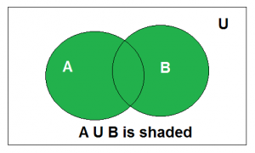

Slide 6
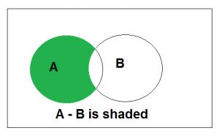
Difference
If A and B are two sets, then their difference is given by A - B or B - A. • If A = {2, 3, 4} and B = {4, 5, 6} A - B means elements of A which are not the elements of B. i.e., in the above example A - B = {2, 3} In general, B - A = {x : x ∈ B, and x ∉ A} • If A and B are disjoint sets, then A – B = A and B – A = B

Slide 7
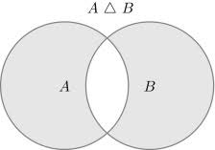
Symmetric Difference
The symmetric difference using Venn diagram of two subsets A and B is a sub set of U, denoted by A △ B and is defined by
A △ B = (A – B) ∪ (B – A)
Let A and B are two sets. The symmetric difference of two sets A and B is the set (A – B) ∪ (B – A) and is denoted by A △ B.
Thus, A △ B = (A – B) ∪ (B – A) = {x : x ∉ A ∩ B}
or, A △ B = {x : [x ∈ A and x ∉ B] or [x ∈ B and x ∉ A]}

Slide 8
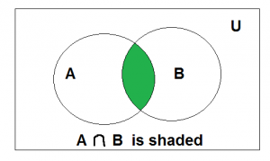
Intersection
Intersection
Let set A = {2, 3, 4, 5, 6}
and set B = {3, 5, 7, 9}
In this two sets, the elements 3 and 5 are common. The set containing these common elements i.e., {3, 5} is the intersection of set A and B.
The symbol used for the intersection of two sets is ‘∩‘.
Therefore, symbolically, we write intersection of the two sets A and B is A ∩ B which means A intersection B.
The intersection of two sets A and B is represented as A ∩ B = {x : x ∈ A and x ∈ B}

Slide 9
The symmetric difference can also be expressed using the XOR operation ⊕ on the predicates describing the two sets in set-builder notation.

Slide 10
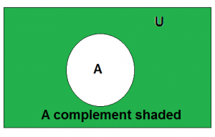
Complement
The complement of set A, denoted by A’ , is the set of all elements in the universal set that are not in A. It is denoted by A’

Slide 11
Countably infinite set
A set is said to be finite if there is a one to one correspondence between the elements in the set and the elements in some set n, where n belongs to N; n is said to be the cardinality of set.
Example: {a,b,c} {a,d,e}
A set is said to be countably infinite if there is a one-one correspondence between the elements in the set and the elements in N.
Example:
Set of all natural numbers {0,1,2,3,4,5,…}
Set of non negative even integer { 0,2,4,6,8,…}

Slide 12
Uncountable infinite sets
A set is said to be Uncountably infinite if there is no one-one correspondence between the elements in the set and the elements in N.
example set of real numbers between 0 and 1.

Slide 13
Simple results

Slide 14
Principle of inclusion and exclusion

Slide 15
Among a class of students, 60 students play football,70 play badminton,25 students play both football and badminton. How many students are there in a class who play some game?

Slide 16
How many integers from 1 to 100 are multiples of 2 or 3?

Slide 18
Let us determine the number of integers between 1 and 250 that are divisible by any of the integers 2,3,5 and 7.

Slide 19
Laws in a set
Idempotent laws:
A ∪ A = A
A ∩ A = A
Associative laws:
(A ∪ B) ∪ C = A ∪ (B ∪ C)
(A ∩ B) ∩ C = A ∩ (B ∩ C)
Commutative laws:
A ∪ B = B ∪ A
A ∩ B = B ∩ A
Distributive laws:
A ∪ (B ∩ C) = (A ∪ B) ∩ (A ∪ C)
A ∩ (B ∪ C) = (A ∩ B) ∪ (A ∩ C)

Slide 20
Identity laws:
A ∪ ∅ = A
A ∩ U = A
A ∪ U = U
A∩∅ = ∅
Involution laws:
(A’)’ = A

Slide 21
Complement laws:
A ∪ A’ = U
A ∩ A’ = ∅
U’ = ∅
∅’ = U
DeMorgan’s laws:
(A ∪ B)’ = A’ ∩ B’
(A ∩ B)’ = A’ ∪ B’

